Slide 1
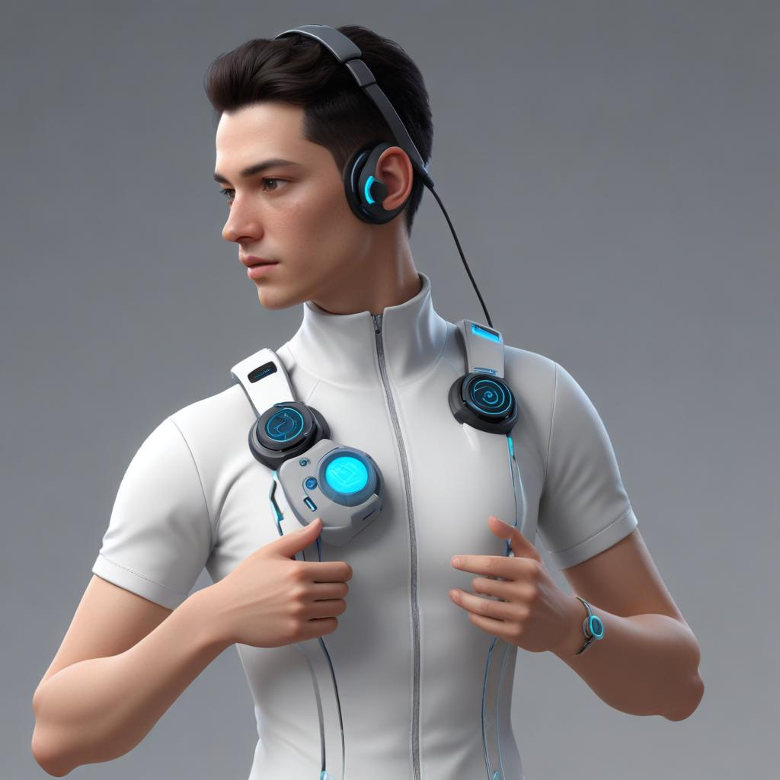
Mono scribe
TEAM-2​

Slide 2

About monoscribe
MonoScribe is a specialized text-to-display device designed to empower deaf individuals by providing seamless communication support. It operates by swiftly translating text input into visually displayed output in real-time, ensuring clarity and immediacy in communication. By presenting text on a digital screen in an easily readable format, MonoScribe enhances accessibility across diverse settings, including educational environments, workplaces, and social interactions. This innovative device aims to foster inclusivity and independence for its users, facilitating more effective communication and promoting a greater sense of connection and participation in everyday interactions

Slide 3

agenda
Introduction
Problem Statement
System Architecture
System Functionality
Implementation and Technology
Benefits and Impact
Conclusion
Q&A Session

Slide 4

introduction
Project Overview
Objectives

Slide 5
project overview
MonoScribe is a text-to-display device designed to assist deaf individuals by converting text input into visually displayed output in real-time
The device enhances communication accessibility by presenting translated text clearly on a digital screen, facilitating effective interaction in various contexts.
Utilizing advanced algorithms, MonoScribe ensures swift and accurate translation of text, promoting inclusivity and empowerment for its users.
Integrating seamlessly into daily life, MonoScribe aims to improve social interactions and enable independent communication for deaf individuals.
Furthermore, our project emphasizes integration with smart city infrastructure, allowing seamless connectivity and interoperability with other urban systems. By integrating with smart parking, public transportation, and waste management systems, we create a more efficient and interconnected urban environment.

Slide 6
project overview
MonoScribe is a text-to-display device designed to assist deaf individuals by converting text input into visually displayed output in real-time
The device enhances communication accessibility by presenting translated text clearly on a digital screen, facilitating effective interaction in various contexts.
Utilizing advanced algorithms, MonoScribe ensures swift and accurate translation of text, promoting inclusivity and empowerment for its users.
Integrating seamlessly into daily life, MonoScribe aims to improve social interactions and enable independent communication for deaf individuals.
Furthermore, our project emphasizes integration with smart city infrastructure, allowing seamless connectivity and interoperability with other urban systems. By integrating with smart parking, public transportation, and waste management systems, we create a more efficient and interconnected urban environment.

Slide 7
project overview
MonoScribe is a text-to-display device designed to assist deaf individuals by converting text input into visually displayed output in real-time
The device enhances communication accessibility by presenting translated text clearly on a digital screen, facilitating effective interaction in various contexts.
Utilizing advanced algorithms, MonoScribe ensures swift and accurate translation of text, promoting inclusivity and empowerment for its users.
Integrating seamlessly into daily life, MonoScribe aims to improve social interactions and enable independent communication for deaf individuals.
Furthermore, our project emphasizes integration with smart city infrastructure, allowing seamless connectivity and interoperability with other urban systems. By integrating with smart parking, public transportation, and waste management systems, we create a more efficient and interconnected urban environment.

Slide 8
project overview
MonoScribe is a text-to-display device designed to assist deaf individuals by converting text input into visually displayed output in real-time
The device enhances communication accessibility by presenting translated text clearly on a digital screen, facilitating effective interaction in various contexts.
Utilizing advanced algorithms, MonoScribe ensures swift and accurate translation of text, promoting inclusivity and empowerment for its users.
Integrating seamlessly into daily life, MonoScribe aims to improve social interactions and enable independent communication for deaf individuals.
Furthermore, our project emphasizes integration with smart city infrastructure, allowing seamless connectivity and interoperability with other urban systems. By integrating with smart parking, public transportation, and waste management systems, we create a more efficient and interconnected urban environment.

Slide 9
project overview
MonoScribe is a text-to-display device designed to assist deaf individuals by converting text input into visually displayed output in real-time
The device enhances communication accessibility by presenting translated text clearly on a digital screen, facilitating effective interaction in various contexts.
Utilizing advanced algorithms, MonoScribe ensures swift and accurate translation of text, promoting inclusivity and empowerment for its users.
Integrating seamlessly into daily life, MonoScribe aims to improve social interactions and enable independent communication for deaf individuals.
Furthermore, our project emphasizes integration with smart city infrastructure, allowing seamless connectivity and interoperability with other urban systems. By integrating with smart parking, public transportation, and waste management systems, we create a more efficient and interconnected urban environment.

Slide 10

objectives
Optimize Battery Efficiency:
aims to ensure that the wearable device uses power-efficient methods to maximize the duration it can operate on a single charge, reducing the need for frequent recharging.

Slide 11

objectives
Optimize Battery Efficiency:
Facilitate Easy Text Input:
aims to ensure that the wearable device uses power-efficient methods to maximize the duration it can operate on a single charge, reducing the need for frequent recharging.
focuses on making it straightforward for users to input text using the ESP8266 and OLED display technologies, enhancing the device's usability and accessibility.

Slide 12
objectives
Optimize Battery Efficiency:
Facilitate Easy Text Input:
Facilitate Easy Updating:
aims to ensure that the wearable device uses power-efficient methods to maximize the duration it can operate on a single charge, reducing the need for frequent recharging.
focuses on making it straightforward for users to input text using the ESP8266 and OLED display technologies, enhancing the device's usability and accessibility.
aims to make it convenient for users to update the device's firmware and software, ensuring that it remains up-to-date with the latest features, improvements, and security patches.

Slide 13
objectives
Optimize Battery Efficiency:
Facilitate Easy Text Input:
Facilitate Easy Updating:
aims to ensure that the wearable device uses power-efficient methods to maximize the duration it can operate on a single charge, reducing the need for frequent recharging.
focuses on making it straightforward for users to input text using the ESP8266 and OLED display technologies, enhancing the device's usability and accessibility.
aims to make it convenient for users to update the device's firmware and software, ensuring that it remains up-to-date with the latest features, improvements, and security patches.
Ensure Data Privacy and Security:
focuses on implementing robust security measures to protect user data and ensure privacy, safeguarding sensitive information transmitted and stored by the wearable device.

Slide 14
objectives
Optimize Battery Efficiency:
Facilitate Easy Text Input:
Facilitate Easy Updating:
aims to ensure that the wearable device uses power-efficient methods to maximize the duration it can operate on a single charge, reducing the need for frequent recharging.
focuses on making it straightforward for users to input text using the ESP8266 and OLED display technologies, enhancing the device's usability and accessibility.
aims to make it convenient for users to update the device's firmware and software, ensuring that it remains up-to-date with the latest features, improvements, and security patches.
Ensure Data Privacy and Security:
Enhance User Interface Intuitiveness:
focuses on implementing robust security measures to protect user data and ensure privacy, safeguarding sensitive information transmitted and stored by the wearable device.
focuses on refining the user interface (UI) of the wearable device to be more intuitive and user-friendly, ensuring a seamless interaction experience for deaf individuals during communication and operation.

Slide 15

Problem Statement
Identifying the Need
Challenges and Opportunities

Slide 16

NEEd statement
The need for MonoScribe is to develop a text-to-display device that enables seamless communication for deaf individuals. This device aims to convert text input into clear visual output in real-time, enhancing accessibility and fostering independent communication in various contexts. By prioritizing simplicity, reliability, and inclusivity, MonoScribe seeks to empower deaf individuals by providing a straightforward and effective tool for everyday communication challenges.

Slide 17







Challenges:
Technological Integration:
Power Management:
User Interface Design:
Reliability and Durability:
Data Security:
User Adoption and Acceptance:
Accessibility and Affordability:
Ensuring seamless integration of various hardware components (such as microcontrollers, display modules) and software algorithms for accurate and real-time text translation.
Designing an intuitive and user-friendly interface that effectively communicates translated text and facilitates easy interaction for both deaf users and caregivers.
Ensuring the device operates reliably under different environmental conditions and over prolonged periods, minimizing hardware failures and maintenance needs.
Addressing potential challenges related to user acceptance, ensuring that the device meets user expectations, preferences, and usability requirements effectively.
nsuring the device remains accessible and affordable for deaf individuals from various socioeconomic backgrounds, considering factors such as production costs, distribution logistics, and potential subsidies or funding options to make the technology widely available
Optimizing battery life and power consumption to ensure extended usability without frequent recharging, especially for wearable devices.
Implementing robust data encryption and privacy measures to protect sensitive information transmitted and stored by the device, ensuring user trust and compliance with data protection regulations.
LUMINA SENSE

Slide 18
Challenges:
Technological Integration:
Power Management:
User Interface Design:
Reliability and Durability:
Data Security:
User Adoption and Acceptance:
Accessibility and Affordability:
Ensuring seamless integration of various hardware components (such as microcontrollers, display modules) and software algorithms for accurate and real-time text translation.
Designing an intuitive and user-friendly interface that effectively communicates translated text and facilitates easy interaction for both deaf users and caregivers.
Ensuring the device operates reliably under different environmental conditions and over prolonged periods, minimizing hardware failures and maintenance needs.
Addressing potential challenges related to user acceptance, ensuring that the device meets user expectations, preferences, and usability requirements effectively.
nsuring the device remains accessible and affordable for deaf individuals from various socioeconomic backgrounds, considering factors such as production costs, distribution logistics, and potential subsidies or funding options to make the technology widely available
Optimizing battery life and power consumption to ensure extended usability without frequent recharging, especially for wearable devices.
Implementing robust data encryption and privacy measures to protect sensitive information transmitted and stored by the device, ensuring user trust and compliance with data protection regulations.
LUMINA SENSE

Slide 19
Challenges:
Technological Integration:
Power Management:
User Interface Design:
Reliability and Durability:
Data Security:
User Adoption and Acceptance:
Accessibility and Affordability:
Ensuring seamless integration of various hardware components (such as microcontrollers, display modules) and software algorithms for accurate and real-time text translation.
Designing an intuitive and user-friendly interface that effectively communicates translated text and facilitates easy interaction for both deaf users and caregivers.
Ensuring the device operates reliably under different environmental conditions and over prolonged periods, minimizing hardware failures and maintenance needs.
Addressing potential challenges related to user acceptance, ensuring that the device meets user expectations, preferences, and usability requirements effectively.
nsuring the device remains accessible and affordable for deaf individuals from various socioeconomic backgrounds, considering factors such as production costs, distribution logistics, and potential subsidies or funding options to make the technology widely available
Optimizing battery life and power consumption to ensure extended usability without frequent recharging, especially for wearable devices.
Implementing robust data encryption and privacy measures to protect sensitive information transmitted and stored by the device, ensuring user trust and compliance with data protection regulations.
LUMINA SENSE

Slide 20
Challenges:
Technological Integration:
User Interface Design:
Reliability and Durability:
User Adoption and Acceptance:
Accessibility and Affordability:
Power Management:
Data Security:
Ensuring seamless integration of various hardware components (such as microcontrollers, display modules) and software algorithms for accurate and real-time text translation.
Designing an intuitive and user-friendly interface that effectively communicates translated text and facilitates easy interaction for both deaf users and caregivers.
Ensuring the device operates reliably under different environmental conditions and over prolonged periods, minimizing hardware failures and maintenance needs.
Addressing potential challenges related to user acceptance, ensuring that the device meets user expectations, preferences, and usability requirements effectively.
nsuring the device remains accessible and affordable for deaf individuals from various socioeconomic backgrounds, considering factors such as production costs, distribution logistics, and potential subsidies or funding options to make the technology widely available
Optimizing battery life and power consumption to ensure extended usability without frequent recharging, especially for wearable devices.
Implementing robust data encryption and privacy measures to protect sensitive information transmitted and stored by the device, ensuring user trust and compliance with data protection regulations.
LUMINA SENSE

Slide 21
Challenges:
User Interface Design:
User Adoption and Acceptance:
Accessibility and Affordability:
Technological Integration:
Reliability and Durability:
Power Management:
Data Security:
Ensuring seamless integration of various hardware components (such as microcontrollers, display modules) and software algorithms for accurate and real-time text translation.
Ensuring the device operates reliably under different environmental conditions and over prolonged periods, minimizing hardware failures and maintenance needs.
Designing an intuitive and user-friendly interface that effectively communicates translated text and facilitates easy interaction for both deaf users and caregivers.
Addressing potential challenges related to user acceptance, ensuring that the device meets user expectations, preferences, and usability requirements effectively.
nsuring the device remains accessible and affordable for deaf individuals from various socioeconomic backgrounds, considering factors such as production costs, distribution logistics, and potential subsidies or funding options to make the technology widely available
Optimizing battery life and power consumption to ensure extended usability without frequent recharging, especially for wearable devices.
Implementing robust data encryption and privacy measures to protect sensitive information transmitted and stored by the device, ensuring user trust and compliance with data protection regulations.
LUMINA SENSE

Slide 22
Challenges:
User Interface Design:
User Adoption and Acceptance:
Accessibility and Affordability:
Technological Integration:
Reliability and Durability:
Power Management:
Data Security:
Ensuring the device operates reliably under different environmental conditions and over prolonged periods, minimizing hardware failures and maintenance needs.
Ensuring seamless integration of various hardware components (such as microcontrollers, display modules) and software algorithms for accurate and real-time text translation.
Designing an intuitive and user-friendly interface that effectively communicates translated text and facilitates easy interaction for both deaf users and caregivers.
Addressing potential challenges related to user acceptance, ensuring that the device meets user expectations, preferences, and usability requirements effectively.
Ensuring the device remains accessible and affordable for deaf individuals from various socioeconomic backgrounds, considering factors such as production costs, distribution logistics, and potential subsidies or funding options to make the technology widely available
Optimizing battery life and power consumption to ensure extended usability without frequent recharging, especially for wearable devices.
Implementing robust data encryption and privacy measures to protect sensitive information transmitted and stored by the device, ensuring user trust and compliance with data protection regulations.
LUMINA SENSE

Slide 23
Challenges:
User Interface Design:
User Adoption and Acceptance:
Accessibility and Affordability:
Technological Integration:
Reliability and Durability:
Power Management:
Data Security:
Ensuring the device operates reliably under different environmental conditions and over prolonged periods, minimizing hardware failures and maintenance needs.
Ensuring seamless integration of various hardware components (such as microcontrollers, display modules) and software algorithms for accurate and real-time text translation.
Designing an intuitive and user-friendly interface that effectively communicates translated text and facilitates easy interaction for both deaf users and caregivers.
Addressing potential challenges related to user acceptance, ensuring that the device meets user expectations, preferences, and usability requirements effectively.
Ensuring the device remains accessible and affordable for deaf individuals from various socioeconomic backgrounds, considering factors such as production costs, distribution logistics, and potential subsidies or funding options to make the technology widely available
Implementing robust data encryption and privacy measures to protect sensitive information transmitted and stored by the device, ensuring user trust and compliance with data protection regulations.
Optimizing battery life and power consumption to ensure extended usability without frequent recharging, especially for wearable devices.
LUMINA SENSE

Slide 24
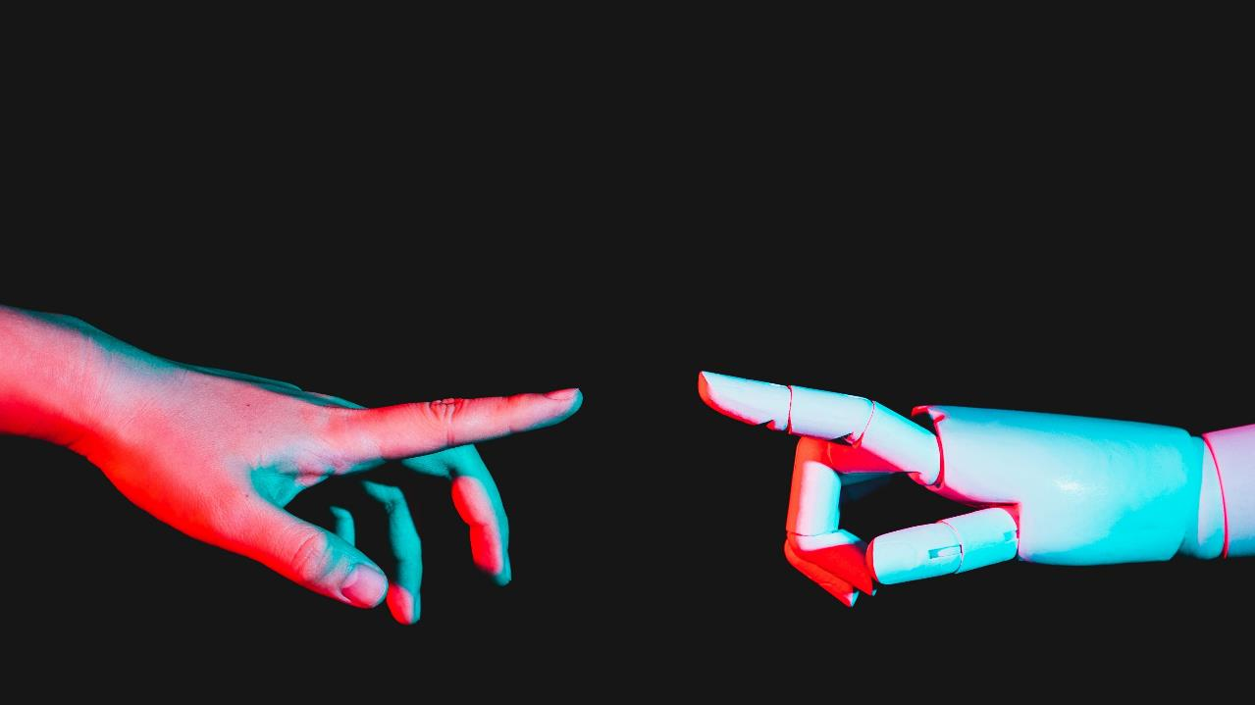
System Architecture

Slide 25
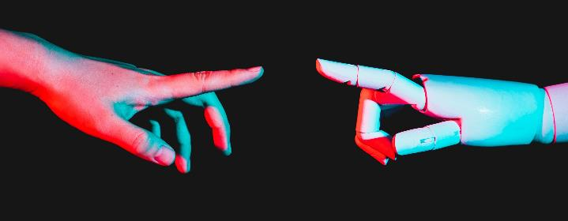
Components and Features Overview:
Text-to-Display Device:
MonoScribe features a compact and portable design equipped with microcontroller units (MCUs) such as ESP8266 or ESP32, responsible for processing and converting text input into visual display output.
Display Module:
The device incorporates an OLED or similar display module to present translated text in a clear and readable format, ensuring effective communication for deaf individuals in real-time
User Interface: :
MonoScribe includes a user-friendly interface designed to facilitate easy interaction, allowing users to input text effortlessly and view translated output without complexity.

Slide 26
Integration with Smartphone App:
Enhancing versatility, the device connects with a smartphone app to expand functionality, enabling features like speech-to-text conversion and remote control options for seamless communication management.
Power Management:
To optimize usability, MonoScribe implements efficient power management strategies, ensuring extended battery life for prolonged use without frequent recharging, crucial for its wearable and portable nature.

Slide 27



SYSTEM FUNCTIONALITY
Captures and processes text input from users, converting it into a format suitable for display.
Translates and displays text in real-time on an OLED screen, ensuring clear and immediate communication.
Monitors and optimizes battery usage to extend the device's operational life, ensuring prolonged usability without frequent recharging.

Slide 28



SYSTEM FUNCTIONALITY
Facilitates communication with external devices, such as smartphones, via Wi-Fi, allowing for additional functionalities like speech-to-text conversion and remote updates.
Implements data encryption and security measures to protect user information and ensure privacy during device operation.
Allows for easy firmware updates to keep the device up-to-date with the latest features, improvements, and security patches.

Slide 29
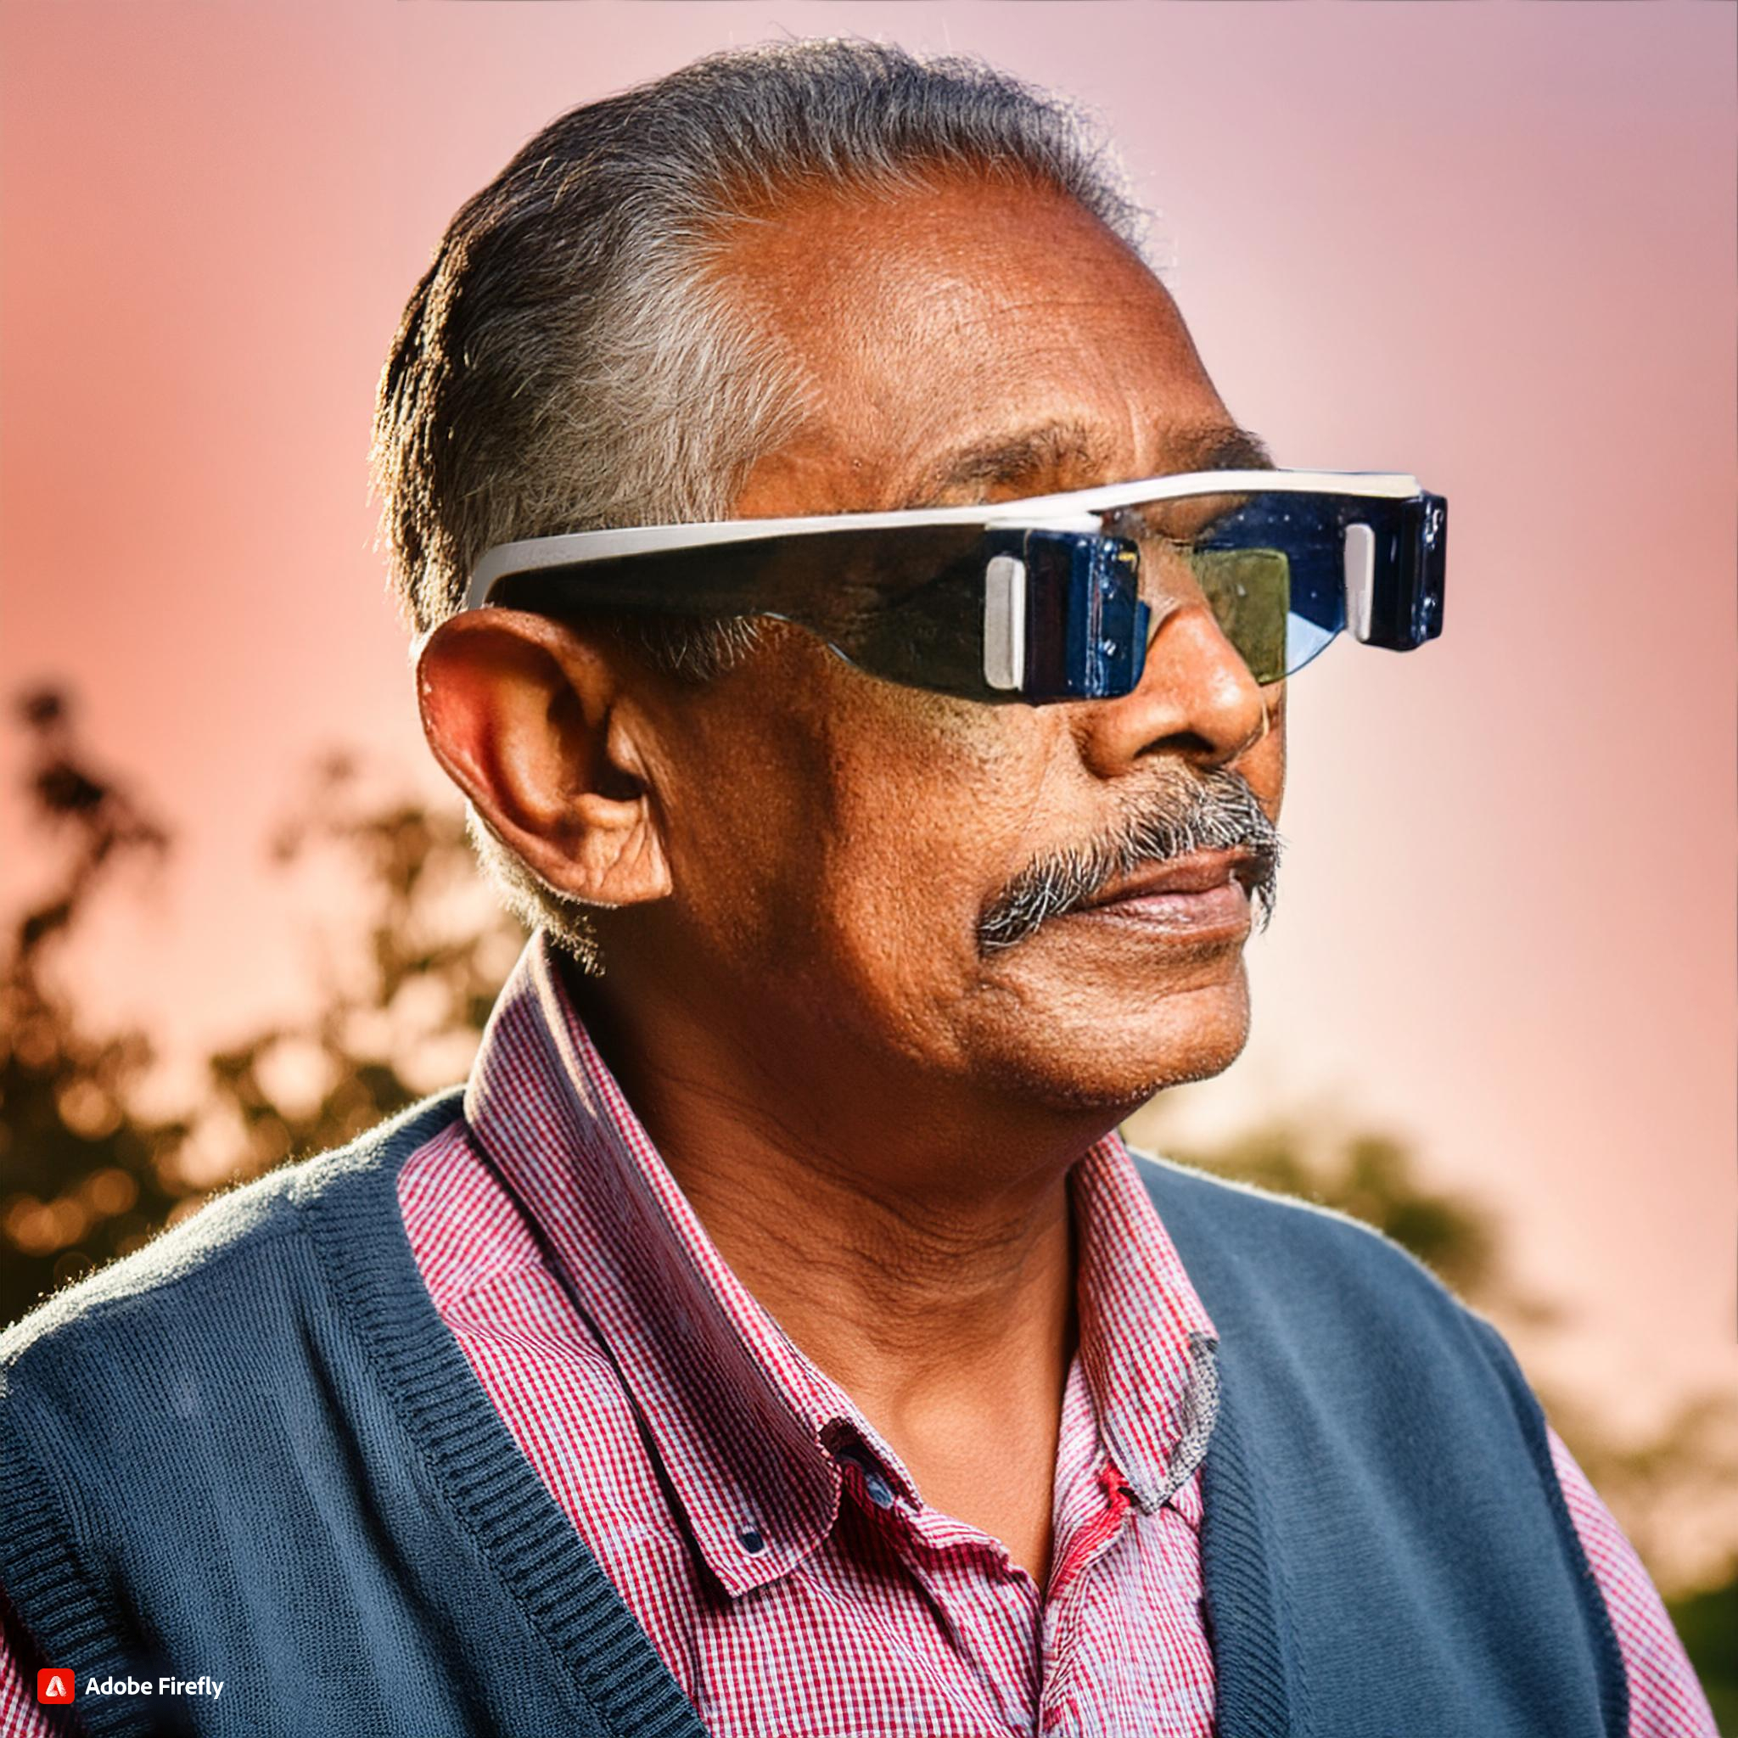
Implementation and technology
- Hardware Components
- Software and Programming
- Integration with Web Interface ​

Slide 30
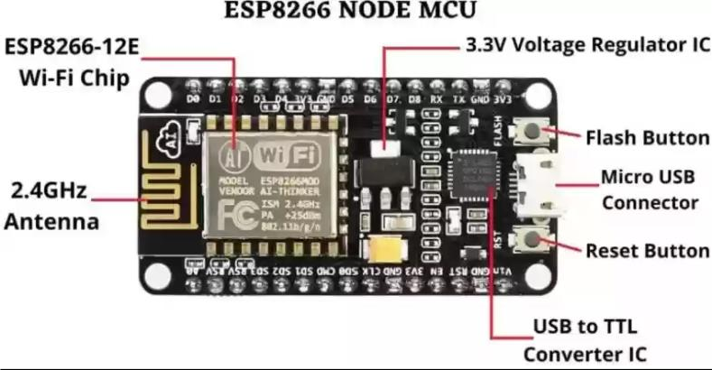
Hardware components
ESP8266 or ESP32 (Microcontroller Unit)
OLED Display Module
Battery
Power Management Circuitry

Slide 31
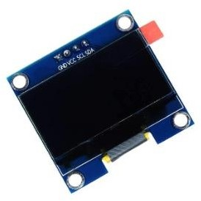
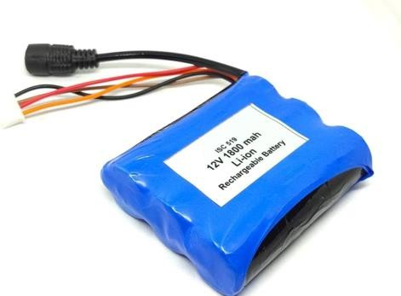
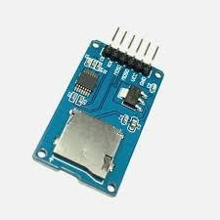
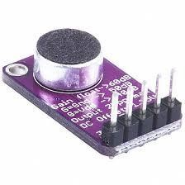
Hardware components
Buttons or Touch Sensors
Wi-Fi Module
Motion Sensors (Optional)
Housing or Enclosure

Slide 32
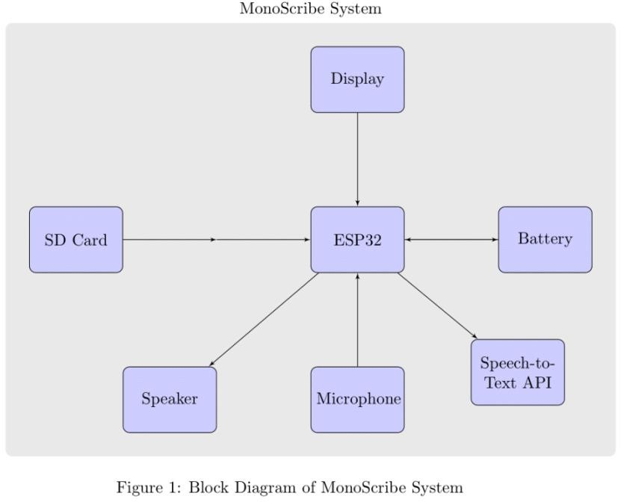
software components
Firmware
User Interface (UI) Software
Text Processing Algorithms
Communication Protocols
Power Management Software
Integration APIs
Testing and Debugging Tools
Security Measures

Slide 33
Integration with Web Interface ​
Web Server Software: Handles incoming requests from MonoScribe for data transmission and interaction.
RESTful APIs: Facilitates communication between the web server and MonoScribe, allowing for data exchange and control.
Data Parsing and Formatting: Converts data from MonoScribe into formats suitable for web display and interaction.
Authentication and Security: Ensures secure and authenticated access to the web interface, maintaining user privacy and data integrity.
Real-Time Data Updates: Enables seamless, real-time updates between MonoScribe and the web interface, ensuring synchronized information display.
These components collectively enable MonoScribe to interface effectively with a web environment, enhancing its functionality and usability in various applications.

Slide 34
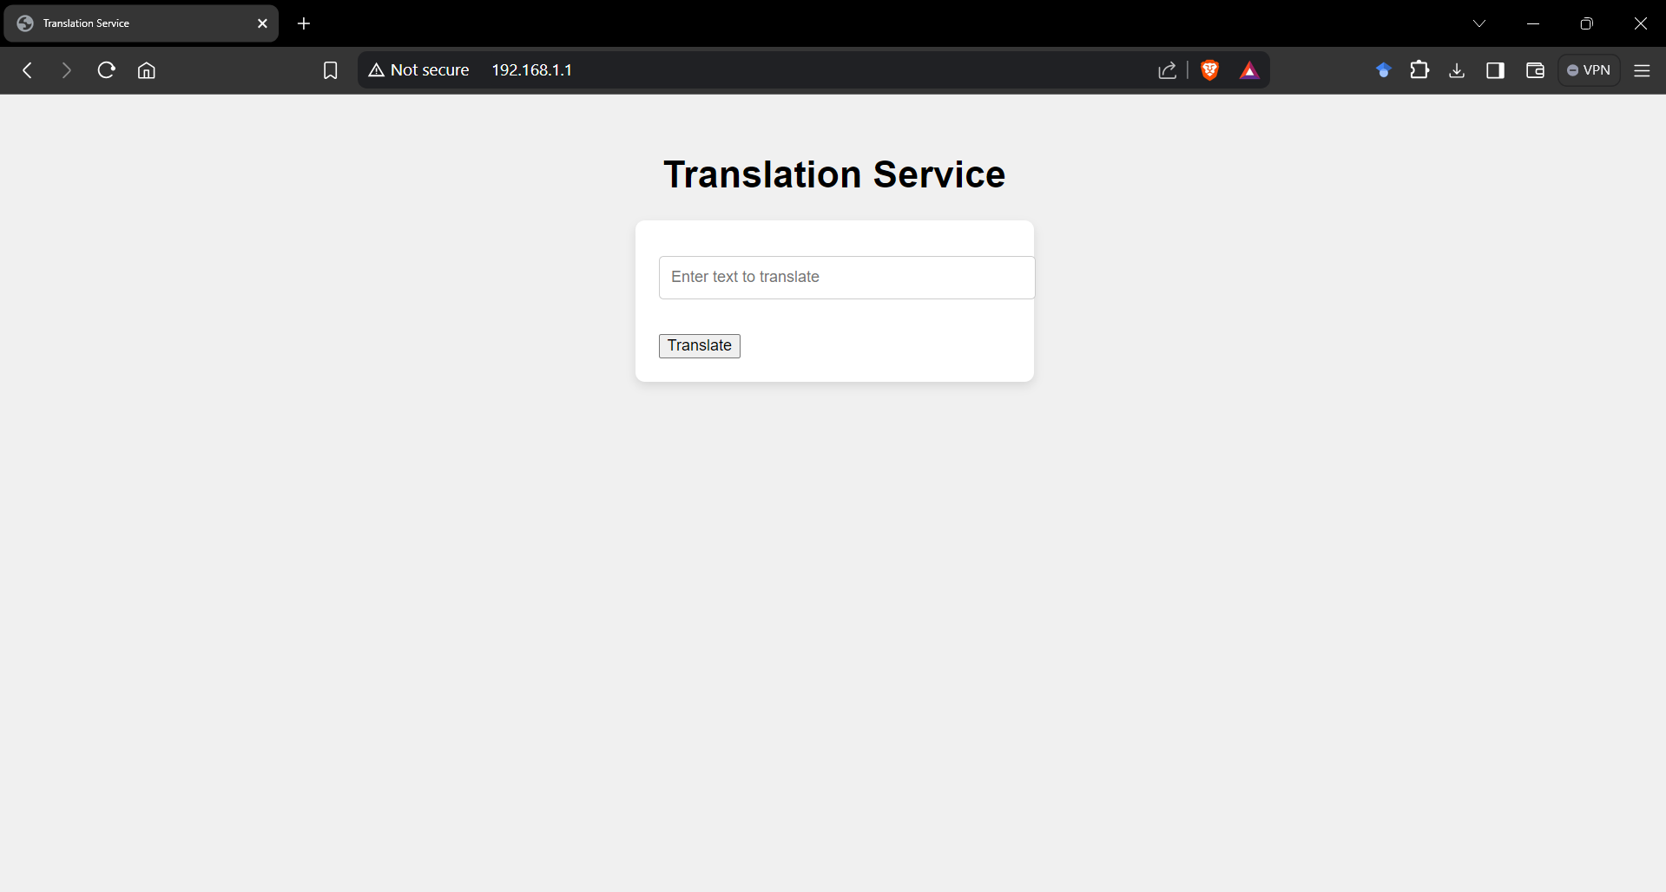
Integration with Web Interface ​

Slide 35
Benefits and Impact:

Slide 36
Benefits :
Enhanced Communication: Provides deaf individuals with a tool to understand and engage in conversations more effectively by converting spoken or signed language into readable text.
Accessibility: Improves accessibility to information and communication in various environments, including educational settings, workplaces, and social interactions.
Independence: Promotes independence by reducing reliance on intermediaries for communication, empowering deaf individuals to express themselves autonomously.
Real-Time Interaction: Facilitates real-time interaction by displaying translated text promptly, enabling immediate responses and participation in conversations.

Slide 37
Benefits :
Versatility: Can be adapted for different languages and communication styles, catering to diverse user needs and preferences.

Slide 38
Potential impact :
Social Inclusion: Fosters social inclusion by bridging communication gaps between deaf and hearing individuals, promoting understanding and cooperation.
Educational Support: Enhances educational opportunities by facilitating communication between deaf students and teachers, improving learning experiences and outcomes.
Employment Opportunities: Increases access to employment opportunities by improving communication abilities in workplace environments.
Technological Advancement: Advances the field of assistive technology by integrating innovative solutions for communication accessibility.

Slide 39
Potential impact :
Quality of Life: Ultimately improves the overall quality of life for deaf individuals by enhancing their ability to communicate effectively and participate more fully in society.

Slide 40

Conclusion
The MonoScribe project represents a significant advancement in assistive technology for deaf individuals. By providing a reliable, real-time text-to-display device, MonoScribe addresses crucial communication challenges faced by the deaf community. Its user-friendly interface, optimized power management, and seamless integration with modern technologies ensure that users can communicate effectively and independently in various settings.

Slide 41
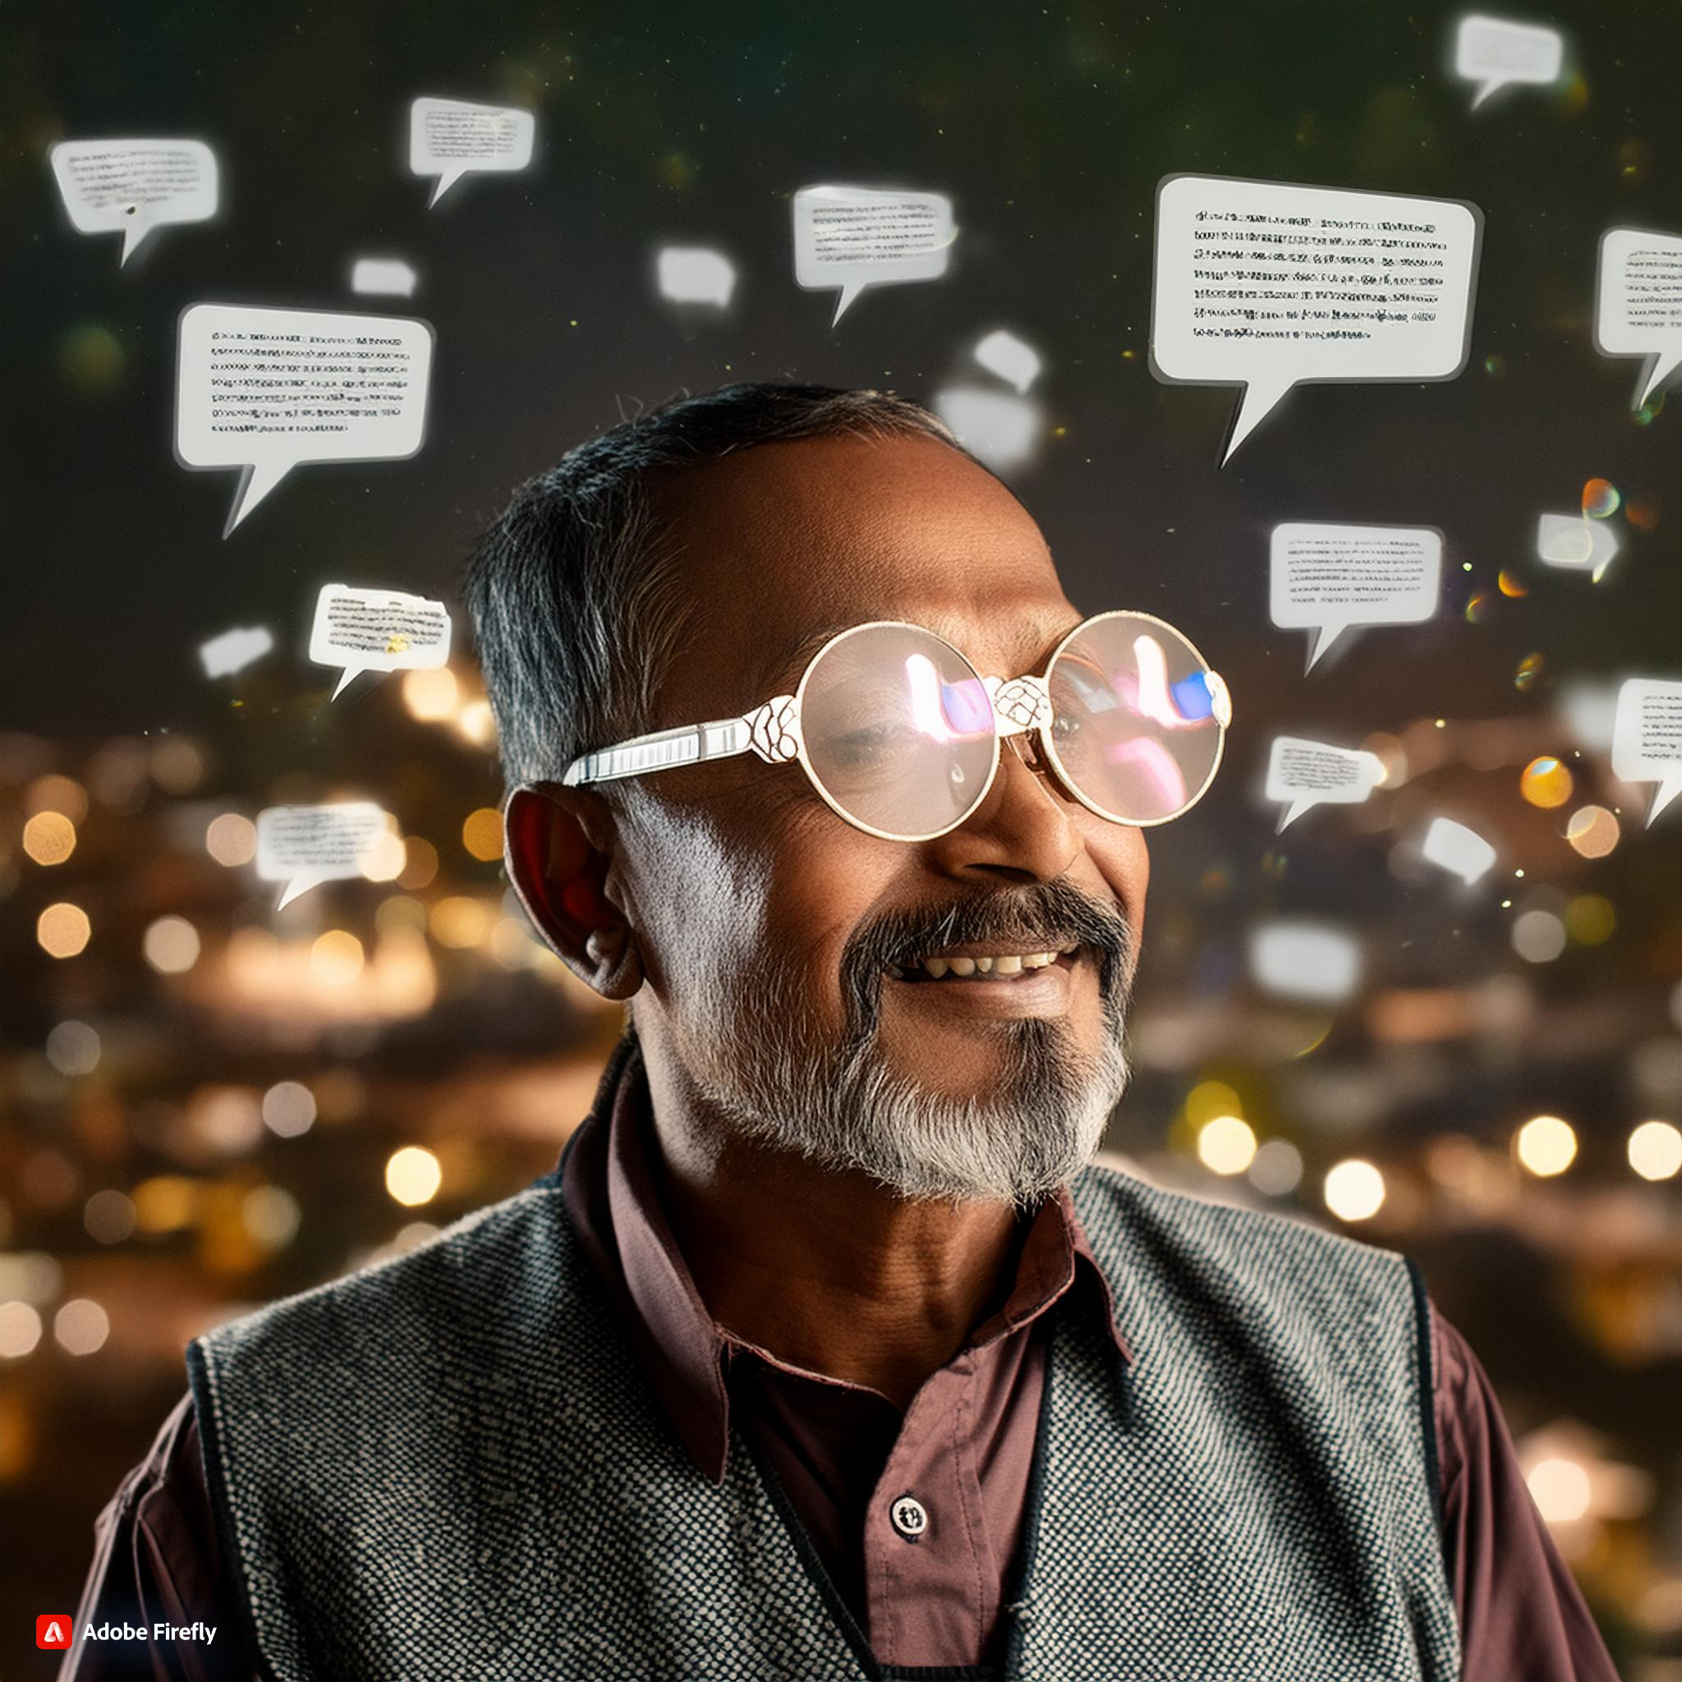
Key takeaways
Enhanced Communication: MonoScribe significantly improves communication for deaf individuals by converting text input into clear, readable visual output in real-time.
User-Friendly Design: The device features an intuitive and accessible interface, making it easy for users to input text and view translations seamlessly.
Technological Integration: MonoScribe leverages advanced technologies such as ESP8266/ESP32 microcontrollers and OLED displays to ensure efficient and reliable performance.
Power Efficiency: With optimized power management, the device offers extended battery life, ensuring prolonged usability without frequent recharging.

Slide 42
Key takeaways
Accessibility and Independence: MonoScribe empowers deaf individuals by providing a tool that reduces reliance on intermediaries, fostering greater independence and self-expression.
Broader Impact: Beyond individual benefits, MonoScribe promotes social inclusion, enhances educational and employment opportunities, and improves the overall quality of life for the deaf community.
Future Potential: The project highlights the transformative potential of assistive technology, demonstrating how innovative solutions can address communication challenges and promote inclusivity in society.

Slide 43

Future Developments and Enhancements
We are actively developing several new features to enhance the MonoScribe device further. These features include real-time speech-to-text functionality and sign language glove integration, allowing deaf users to reply with their sign language being converted into speech. Additionally, we are working on optimizing network efficiency to ensure these features run smoothly and effectively. Customizable display settings and multi-language support are also being added to make the device more user-friendly and accessible to a wider audience. These improvements are currently under development and will be integrated into the existing system to provide a comprehensive communication solution for both deaf individuals and those who have difficulty speaking.

Slide 44





Meet the team
sruthika
ARJUN KOLLIPARA​​
Keerthi ​​
Murali
Kartik​​

Slide 45
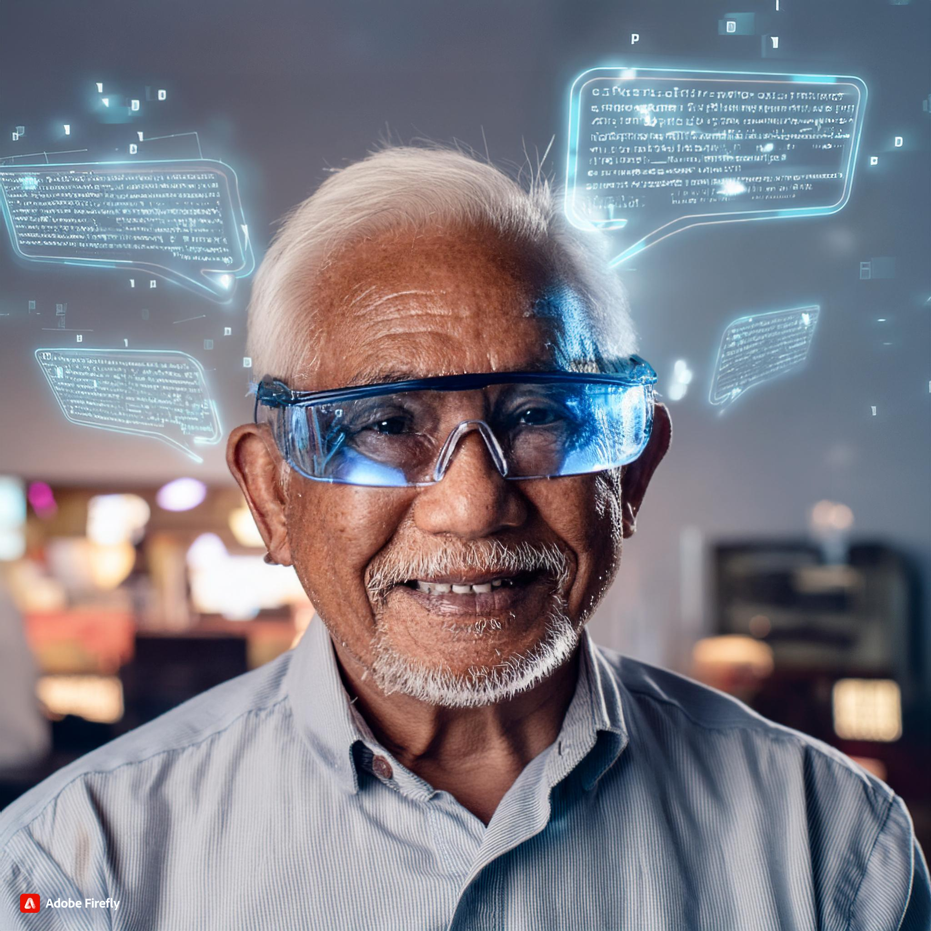
Summary
The MonoScribe project is dedicated to developing an advanced text-to-display device designed to enhance communication for deaf individuals. By converting text input into clear visual output in real-time, MonoScribe facilitates seamless interaction in various contexts. The device features a user-friendly interface, leveraging technologies like ESP8266/ESP32 microcontrollers and OLED displays to ensure efficient and reliable performance.

Slide 46

Thank you
TEAM-2
22h51a0502@CMRCET.AC.IN
22h51a0518@CMRCET.AC.IN
22h51a0520@CMRCET.AC.IN
22h51a0531@CMRCET.AC.IN
22h51a0535@CMRCET.AC.IN

Slide 47
Q&A Session

